Slide 1

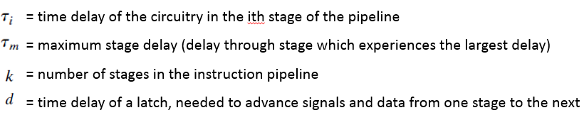

Design Issues of Pipeline
The cycle time of an instruction pipeline is the time needed to advance a set of instructions one stage through the pipeline. The cycle time can be determined as:
Where,

Slide 2

Design Issues of Pipeline: (Cont’d….)
Let Tk,n be the total time required for a pipeline with k stages to execute n instructions. Then,
A total of k cycles are required to complete the execution of the first instruction, and the remaining n-1 instructions require n-1 cycles.
consider a processor with equivalent functions but no pipeline, and assume that the instruction cycle time is

Slide 3

Design Issues of Pipeline: (Cont’d….)
The speedup factor for the instruction pipeline compared to execution without the pipeline is defined as
Problem: What is the speedup factor of 6 stage pipeline system to execute a program of 20 instructions?
Hint: n =20 and k=6

Slide 4
Pipeline Hazards
When the pipeline, or some portion of the pipeline, must stall because conditions do not permit continued execution then pipeline hazard occurs
Such a pipeline stall is also referred to as a pipeline bubble.
Types of hazards:
Resource Hazard
Data Hazard and
Control Hazard .

Slide 5
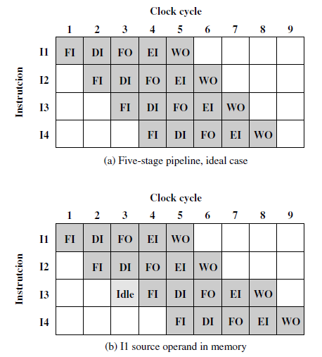
Resource Hazards
Assume that main memory has a single port and that all instruction fetches and data reads and writes must be performed one at a time.
Assume that the source operand for instruction I1 is in memory, rather than a register.
Therefore, the fetch instruction stage of the pipeline must idle for one cycle before beginning the instruction fetch for instruction I3

Slide 6
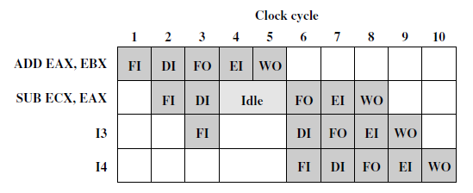
Data Hazards
Read after write (RAW), or true dependency
Write after read (RAW), or anti-dependency
Write after write (RAW), or output dependency.

Slide 7
Control Hazards
Dealing with Branches
Multiple streams
Pre-fetch branch target
Loop buffer
Branch prediction
Delayed branch

Slide 8
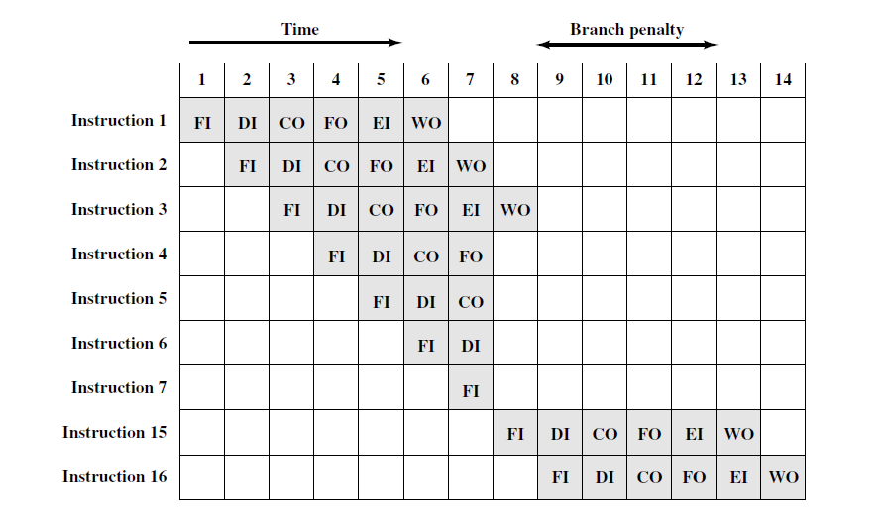
Control Hazard due to branching
Due to Conditional Branch the branch penalty of 4 cycles is obtained

Slide 9
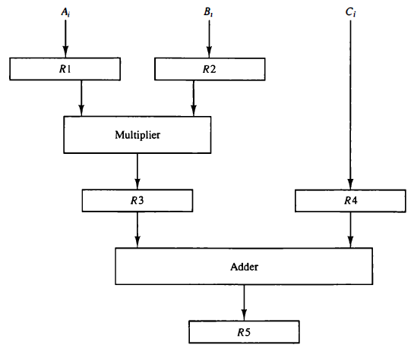


Introduction to Parallel processing
Example of parallel processing

Slide 10
Introduction to Parallel processing (Cont’d…..)
Parallel processing may occur in the instruction stream, in the data stream, or in both. Flynn's classification divides computers into four major groups as follows:
Single instruction stream, single data stream (SISD)
Single instruction stream, multiple data stream (SIMD)
Multiple instruction stream, single data stream (MISD)
Multiple instruction stream, multiple data stream (MIMD)

Slide 11
Introduction to Parallel processing (Cont’d….)
Single Instruction Stream, Single data stream(SISD)-A computer architecture in which a single uni-core processor executes a single instruction stream, to operate on data stored in a single memory.
Single Instruction, Multiple Data (SIMD) system: A single machine instruction controls the simultaneous execution of a number of processing elements on a lockstep basis. Each processing element has an associated data memory, so that each instruction is executed on a different set of data by the different processors. Vector and array processors fall into this category
Multiple Instruction, Single Data (MISD) system :A sequence of data is transmitted to a set of processors, each
of which executes a different instruction sequence. This structure has never been implemented.
Multiple Instruction, Multiple Data (MIMD) system: A set of processors simultaneously execute different
instruction sequences on different data sets. SMPs, clusters, and NUMA systems fits into this category.

Slide 12
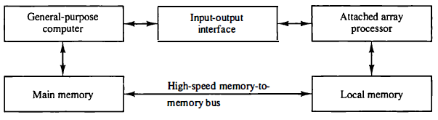
Attached Array Processor
An attached array processor is an auxiliary processor attached to a general-purpose computer. It is intended to improve the performance of the host computer in specific task.
Attached array processor with host computer

Slide 13
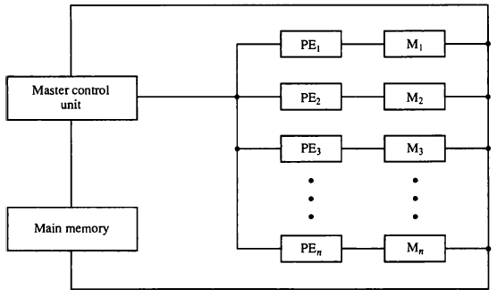
SIMD array processor
An Single Input Multi Data (SIMD) array processor is a computer with multiple processing units operating in parallel.
SIMD array processor organization

